Slide 1

QER 11066
QER: MERAKES EAST PROJECT SF216608C002.06 - Longitudinal scratches on zeta wire

Slide 2
Pipe section / details
Item | Traceability / identification
Project number | SF216608C002
Project name | MERAKES EAST PROJECT
Pipe section | SF216608C002.06
ST number | ST254.72048
Affected layer / equipment | Zeta vault spiralling
Length affected | 806.8m until 809.4m
Drawing number / MP code / STA / Dimension | ZETA 12 FI 11(MP746)

Slide 3
Overview of anomaly
Problem Description:-
During the zeta spiraling of MERAKES EAST PROJECT SF216608C002.06 (ST254.72048), longitudinal scratches on zeta wire was detected at start length 806.8m until 809.4m on pipe.
The details of measurement are as per below.
- Depth: 57um
- Upsetting: 68um
Root Cause:-
The Scratches was observed from incoming wire in bobbin #011, Therefore, the bobbin was replaced and quarantine for further investigation.
The root causes are as below:
1. Suspect wire escape from path of roller and make contact to locking roller at accumulator
2. Suspect wire escape from path of roller at straightener roller.
Problem Handling:-
According to project acceptance criteria CD_216608C002_str25472048_TR01-09_rev0_An_Pressure vault, the maximum allowable criteria for the depth of surface defects is 100um and for the maximum upsetting is 50um. Thus, this defect depth was accepted as it is. However, the upsetting defect has been removed by buffing.

Slide 4
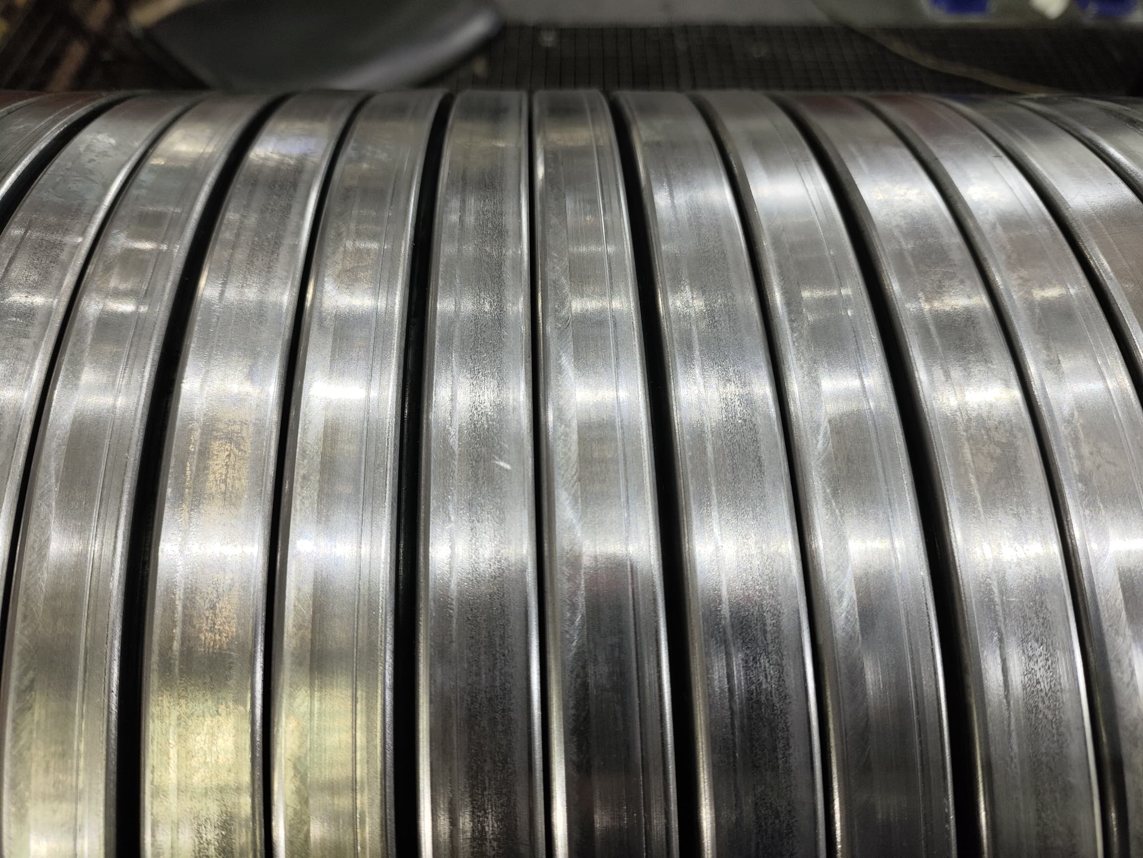
Longitudinal scratches on zeta wire
Figure 1 : Longitudinal scratches on zeta wire was detected at start length 806.8m until 809.4m on pipe.

Slide 5
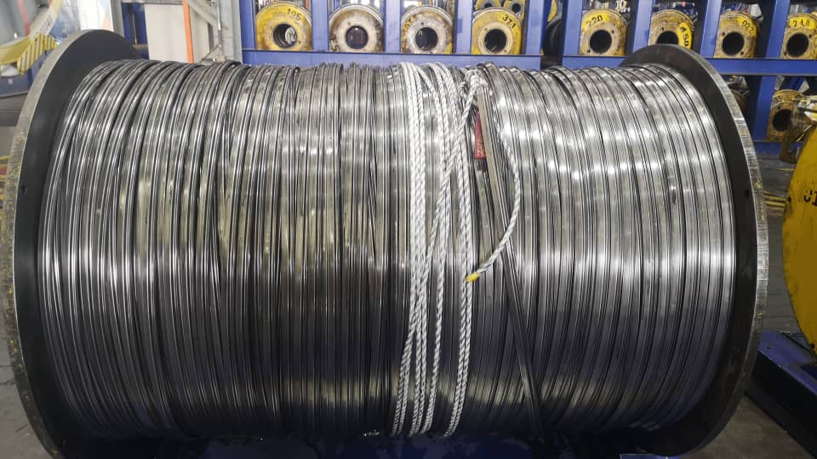
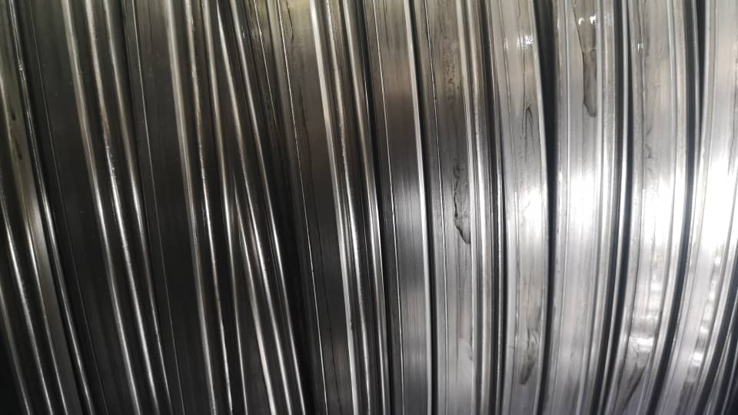
Root Cause
Figure 2 : The Scratches was observed from incoming wire in bobbin #011, Therefore, the bobbin was replaced and quarantine for further investigation.

Slide 6
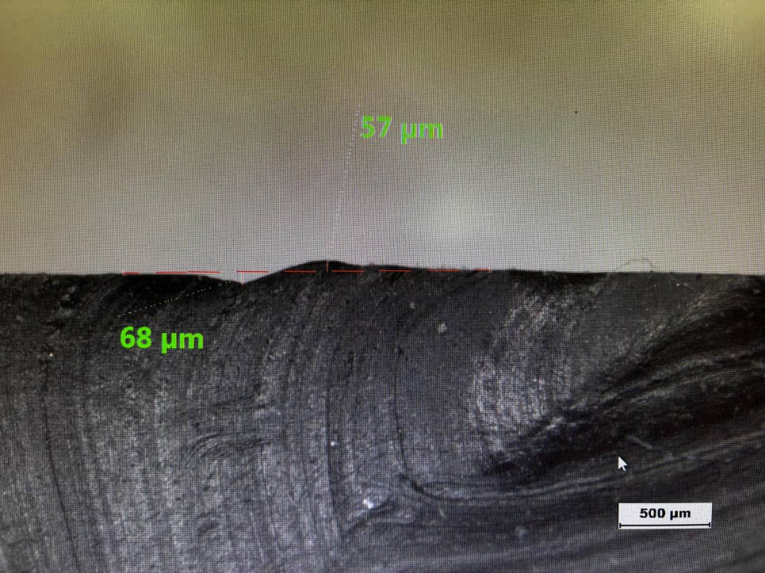
Plastic copy measurement
Figure 3 : According to project acceptance criteria CD_216608C002_str25472048_TR01-09_rev0_An_Pressure vault, the maximum allowable criteria for the depth of surface defects is 100um and for the maximum upsetting is 50um.

Slide 7
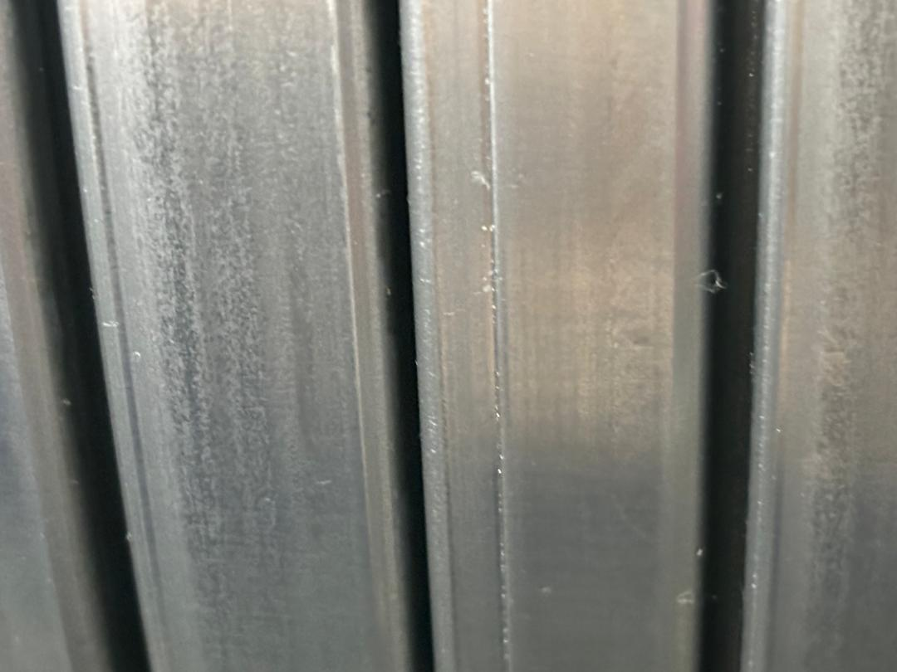
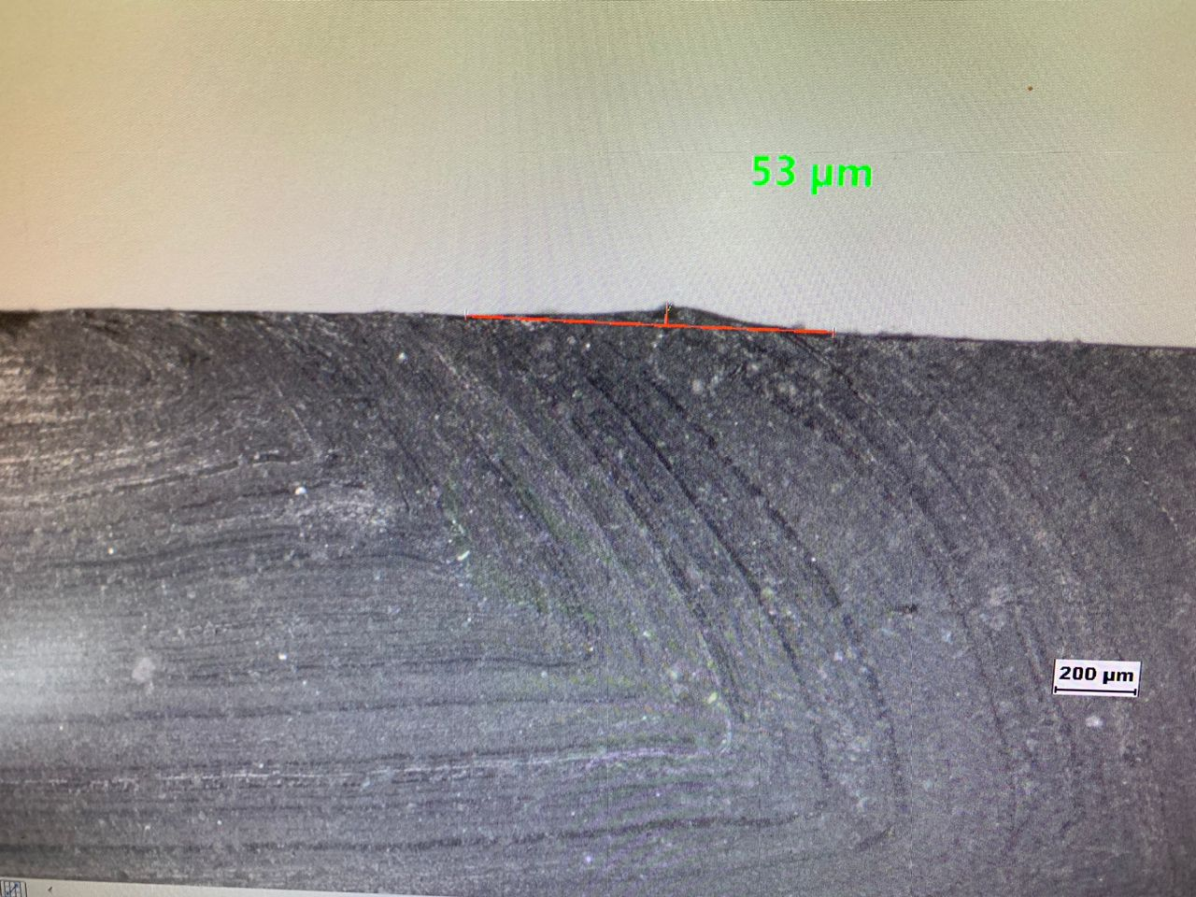
Repaired photo
Plastic copy measurement indication no upsetting after completed buffing
Figure 4 : Defect depth was accepted as it is. However, the upsetting defect has been removed by buffing.

Slide 8

THANK YOU

